Slide 1

Prepared & Presented By: Vijay Jangra

Slide 2
Introduction
The Protection of Children from Sexual Offences (POCSO) Act, 2012 is a landmark law enacted by the Government of India to protect children under the age of 18 from sexual abuse and exploitation.
The Act provides a robust legal framework for the prevention, reporting, investigation, and adjudication of sexual offences against children.

Slide 3
Background:
Need for the POCSO Act
Before the POCSO Act, laws addressing sexual offenses against children in India were inadequate and fragmented.
The Indian Penal Code (IPC) did not comprehensively cover various forms of sexual abuse, nor did it specifically recognize children as vulnerable victims in need of special protection.
The increasing incidents of child abuse and the need for a dedicated legal mechanism led to the creation of the POCSO Act.

Slide 4
Key Objectives
Protect children from sexual assault, sexual harassment, and pornography.
Provide a child-friendly system for reporting, investigation, and trial.
Ensure speedy justice through Special Courts.
Maintain the best interests of the child as the central focus.

Slide 5
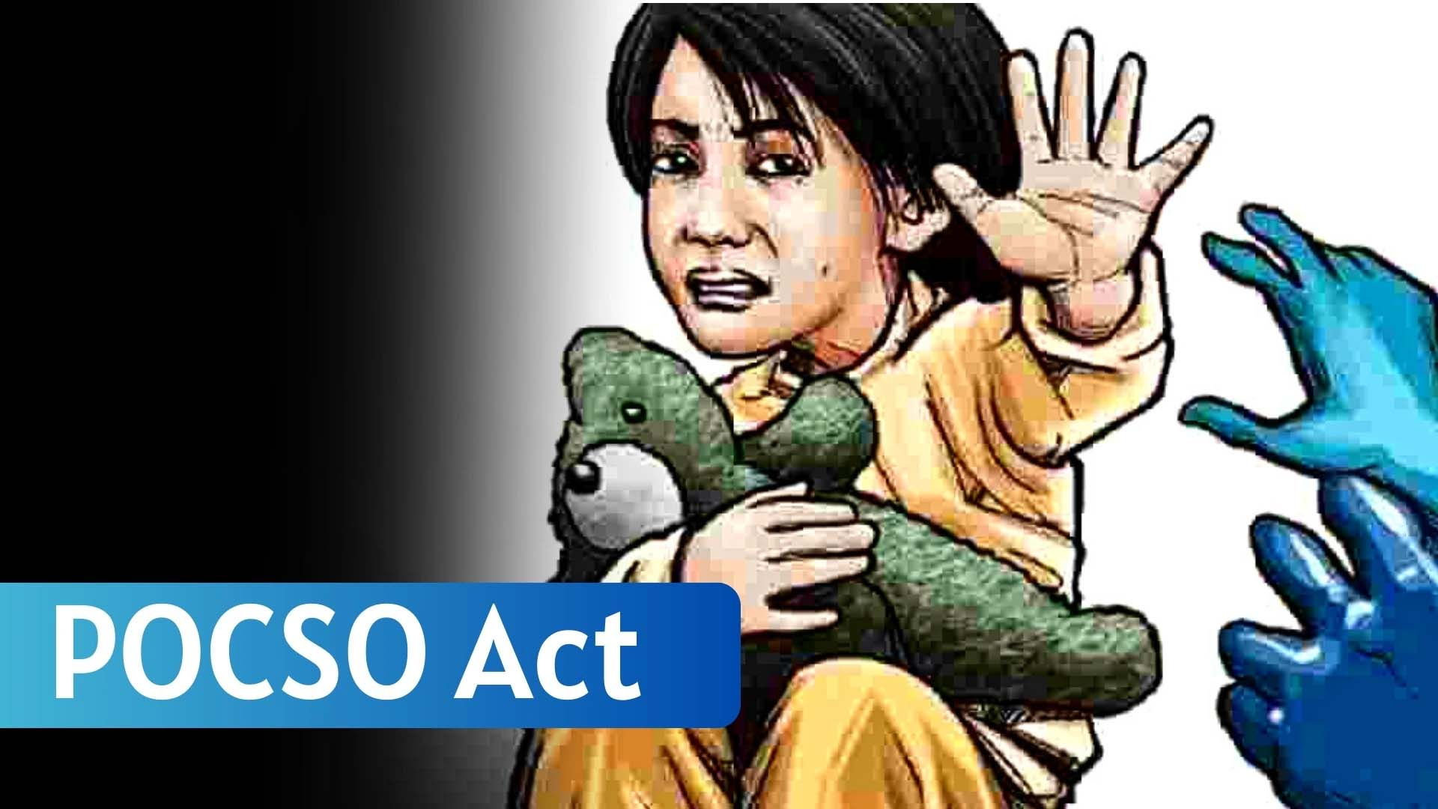
Salient
Features of the

Slide 6
Comprehensive Definitions:
The Act clearly defines various forms of sexual offenses, including:
Penetrative Sexual Assault.
Aggravated Penetrative Sexual Assault.
Sexual Assault.
Sexual Harassment.
Child Pornography.

Slide 7
Gender-Neutral Law:
The Act applies to both boys and girls under the age of 18.
Child-Friendly Procedures:
Special provisions to make the reporting, recording, and trial processes less traumatic for children.
Mandatory Reporting:
Any person aware of a sexual offense against a child must report it to the police. Failure to do so can lead to punishment.

Slide 8
Special Courts:
The Act mandates the establishment of Special Courts to conduct trials in a child-friendly manner and within a time-bound framework.
Confidentiality:
The identity of the child victim must be kept confidential, and media reporting is restricted.
Time-Bound Trials:
The investigation must be completed within 2 months, and the trial within 6 months from the date of taking cognizance.

Slide 9
Punishments:
The Act prescribes stringent punishments, including:
Penetrative Sexual Assault: Minimum 10 years, which may extend to life imprisonment.
Aggravated Penetrative Sexual Assault: Minimum 20 years to life imprisonment or the death penalty.
Sexual Harassment: Up to 3 years of imprisonment.
Use of Child for Pornography: Minimum 5 years, extendable to 7 years or more.

Slide 10

Important
Provisions

Slide 11
Key Sections of the POCSO Act
Section 3: Defines Penetrative Sexual Assault.
Section 5: Defines Aggravated Penetrative Sexual Assault (by relatives, police, public servants, etc.).
Section 7: Defines Sexual Assault (non-penetrative).
Section 9: Defines Aggravated Sexual Assault.
Section 11: Defines Sexual Harassment of a Child.
Section 13: Covers Use of a Child for Pornography.

Slide 12
Amendments to the POCSO Act
Stricter punishments, including the death penalty for aggravated penetrative sexual assault.
Enhancement of punishments for offences related to child pornography.
Measures to address the rising incidents of child abuse more effectively.

Slide 13
Reporting Mechanism
Steps to File a Complaint
Inform the Police:
Report the incident to the nearest police station.
The police are required to record the complaint in writing and provide a copy to the complainant.
Child Welfare Committee (CWC):
Involve the CWC to ensure the child’s safety and welfare.
Special Juvenile Police Unit (SJPU):
Specialized units trained to handle child abuse cases.
Online Reporting:
Complaints can also be lodged via the National Commission for Protection of Child Rights (NCPCR) website or helplines like 1098.

Slide 14
Trial and Investigation
Child-Friendly Procedures
Recording Statements:
Statements must be recorded in the child’s own words.
The presence of a trusted adult or guardian is allowed.
Avoidance of Repeated Interviews:
To minimize trauma, repeated questioning is discouraged.
Special Courts:
Trials are conducted in-camera to protect the child’s identity.
The child is not exposed to the accused during the trial.
Support Persons:
Children are entitled to assistance from support persons (NGOs or counselors) throughout the legal process.

Slide 15
Challenges in Implementation
Delayed Reporting: Fear, stigma, and lack of awareness delay reporting of abuse.
Overburdened Legal System: Backlogs in courts hinder timely justice.
Lack of Training: Inadequate training for police and judicial officers affects the handling of cases.
Psychological Impact: Lack of adequate psychological support for victims.

Slide 16
Case Studies
Kathua Case (2018)
A high-profile case of a young girl who was sexually assaulted and murdered, which drew nationwide outrage and led to amendments strengthening the POCSO Act.
Delhi School Case
A teacher convicted for sexually assaulting students, highlighting the importance of vigilance in educational institutions.

Slide 17
Role of Society
Awareness Campaigns:
Schools, communities, and media must promote awareness of child safety.
Parental Guidance:
Educating children about good touch and bad touch.
NGOs and Support Groups:
Providing counseling, legal aid, and rehabilitation.

Slide 18
Recommendations
Regular Training: For police, judiciary, and educators.
Child Protection Policies: Mandatory in all institutions.
Counseling Services: Available for victims and their families.
Community Involvement: Encourage reporting and vigilance.

Slide 19
Conclusion
The POCSO Act is a crucial step toward ensuring a safe environment for children.
However, its effectiveness depends on proper implementation, awareness, and a collective effort from the government, institutions, parents, and society at large.
By protecting children, we are safeguarding the future of our nation.

Slide 20

THANK YOU

