Slide 1

Group Presentation
A Detailed Overview
Prepared By: Vijay Jangra
Presented By:
Praveen Grewal

Slide 2
Introduction
Group presentations are collaborative efforts where two or more individuals work together to prepare and deliver content to an audience.
They are an essential part of education, professional development, and team-based environments.
Group presentations help develop communication skills, teamwork, critical thinking, and the ability to convey information effectively.
Today we will explore the importance, process, challenges, and strategies for delivering successful group presentations.

Slide 3
Importance of Group Presentations
Enhances Teamwork Skills: Encourages students and professionals to collaborate, share ideas, and delegate tasks.
Improves Communication Skills: Provides practice in public speaking, explaining concepts clearly, and using visual aids.
Promotes Critical Thinking: Requires participants to analyze, evaluate, and synthesize information collaboratively.
Builds Confidence: Gives individuals the opportunity to practice speaking in front of a group, boosting self-confidence.
Prepares for Real-World Scenarios: Mimics workplace environments where team projects and collaborative presentations are common.
Develops Time Management: Helps participants manage deadlines, allocate tasks effectively, and balance responsibilities.

Slide 4
Steps to Prepare a Group Presentation
1. Topic Selection and Research
  Choose a Relevant Topic: The group should select a topic that aligns with the assignment or objective.
  Conduct Research: Gather information from credible sources and ensure that all group members are familiar with the content.
2. Planning and Organization
  Set Objectives: Define the goals of the presentation and what the audience should learn.
  Outline the Content: Create a clear structure, including an introduction, body, and conclusion.
  Assign Roles: Distribute tasks based on each member’s strengths and interests (e.g., researcher, speaker, visual aid designer).

Slide 5
Steps to Prepare a Group Presentation
3. Content Development
  Develop Key Points: Each member should contribute to the development of the presentation’s key ideas.
  Create Visual Aids: Prepare slides, charts, or videos that support the presentation and keep the audience engaged.
4. Rehearsal
  Practice Together: Rehearse the full presentation as a group to ensure smooth transitions and timing.
  Seek Feedback: Get feedback from peers or mentors to refine the delivery and content.

Slide 6
Steps to Prepare a Group Presentation
5. Presentation Delivery
  Introduce the Group: Briefly introduce each group member and their role in the presentation.
  Engage the Audience: Use eye contact, clear speech, and interactive elements like questions or activities.
  Maintain Cohesion: Ensure that transitions between speakers are seamless and the presentation remains coherent.
6. Q&A Session
  Prepare for Questions: Anticipate possible questions and decide who will answer specific types of queries.
  Conclude Effectively: Summarize the main points and thank the audience.

Slide 7

Components of a Successful Group Presentation

Slide 8
Components of a Successful Group Presentation
Introduction:
  Briefly state the purpose and objectives of the presentation.
  Introduce team members and outline the presentation structure.
Body:
  Divide the content into clear sections, with each member presenting their portion.
  Use visual aids, examples, and real-world applications to clarify points.
Conclusion:
  Recap the main ideas and findings.
  Provide a strong closing statement and invite questions.
Q&A:
  Respond to audience questions confidently and concisely.

Slide 9
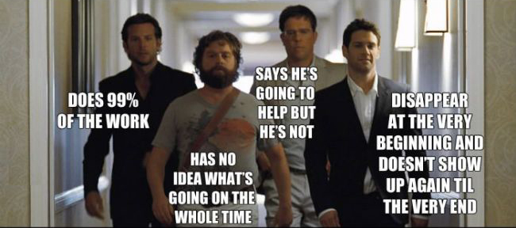

Slide 10
Challenges in Group Presentations
Unequal Participation:
  Some members may dominate while others contribute less.
  Solution: Assign clear roles and ensure everyone has a speaking part.
Coordination Issues:
  Scheduling conflicts can hinder preparation and practice.
  Solution: Use digital tools (e.g., Google Meet, Zoom) to facilitate virtual meetings.
Lack of Cohesion:
  Presentations may seem disjointed if transitions are not planned.
  Solution: Practice transitions and ensure everyone understands the flow.
Nervousness:
  Stage fright can affect performance.
  Solution: Rehearse thoroughly and use relaxation techniques.

Slide 11
Strategies for Effective Group Presentations
Plan Ahead: Start early to allow sufficient time for research, preparation, and practice.
Clear Division of Roles: Assign specific tasks to each member, such as researcher, speaker, designer, or timekeeper.
Use Visual Aids: Enhance understanding with slides, videos, or charts, but avoid cluttered visuals.
Practice Transitions: Ensure smooth handovers between speakers to maintain a cohesive flow.
Engage the Audience: Ask questions, incorporate activities, or include brief discussions to maintain interest.
Time Management: Allocate time for each section and practice staying within the overall time limit.
Rehearse Thoroughly: Practice as a group multiple times to build confidence and identify areas for improvement.
Prepare for Technical Issues: Have backups of slides or materials and be ready to adapt if technology fails.
Maintain Professionalism: Dress appropriately, speak clearly, and respect each other’s contributions.

Slide 12
Evaluation Criteria for Group Presentations
Content Quality: Is the information accurate, relevant, and well-researched?
Organization and Structure: Is the presentation logically structured with a clear introduction, body, and conclusion?
Delivery: Are the speakers clear, confident, and engaging?
Visual Aids: Do the visuals enhance the presentation without overwhelming it?
Teamwork and Coordination: Did the group members collaborate effectively?
Q&A Performance: Did the group handle questions confidently and accurately?

Slide 13

Conclusion
Group presentations are a powerful tool for developing essential skills such as teamwork, communication, and critical thinking.
When well-prepared, they provide a dynamic way to engage audiences and share knowledge.
By understanding the process, addressing challenges, and applying effective strategies, groups can deliver successful and impactful presentations that benefit both the presenters and the audience.

Slide 14


Thank You

