Slide 1
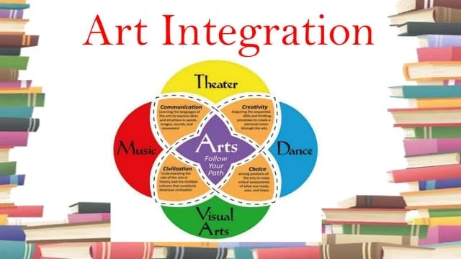
Prepared By: Vijay Jangra
Presented By: Praveen Grewal

Slide 2
Introduction to Art-Integrated Education
Art-Integrated Education (AIE) is an approach that uses various forms of art — visual, performing, and literary — to teach academic subjects.
In this approach, art is not a separate activity but woven into the curriculum to create holistic, engaging, and experiential learning experiences for students.
It aims to enhance learning outcomes, foster creativity, and develop life skills.
The National Education Policy (NEP) 2020 emphasizes the importance of art-integrated learning in achieving cognitive, socio-emotional, and psychomotor objectives.

Slide 3
Objectives of Art-Integrated Education
Promote Holistic Development: To encourage the development of cognitive, emotional, and physical skills through art-based learning.
Enhance Pedagogical Skills: To equip teachers with innovative and creative teaching methods.
Create Engaging Classrooms: To help teachers design interactive and dynamic classroom experiences.
Foster Inclusivity: To provide differentiated instruction catering to varied learning styles.
Encourage Critical Thinking and Problem-Solving: To develop 21st-century skills through integrated learning activities.
Improve Teacher-Student Relationships: To encourage better communication and collaboration between teachers and students.

Slide 4
Key Principles of Art-Integrated Education
Interdisciplinary Learning: Integration of subjects like mathematics, science, languages, and social studies with various art forms such as painting, music, dance, drama, and storytelling.
Experiential Learning: Emphasis on hands-on experiences, projects, and real-world applications through artistic expression.
Student-Centric Approach: Focusing on individual students' interests, abilities, and creativity rather than rote learning.
Skill Development: Enhancing cognitive, emotional, and psychomotor skills by incorporating art-based activities.
Inclusivity and Equity: Catering to diverse learners, including those with special needs, through accessible and flexible teaching strategies.

Slide 5
Types of Art Forms for Integration
Visual Arts:
Drawing, Painting, Collage, Sculpture, Photography
Tools: Sketchbooks, crayons, paints, clay, digital design software
Performing Arts:
Music, Dance, Drama, Theatre
Tools: Musical instruments, costumes, scripts, props, recordings
Literary Arts:
Poetry, Creative Writing, Storytelling
Tools: Journals, creative writing prompts, digital platforms
Crafts:
Origami, Weaving, Pottery
Tools: Craft materials, recycled items

Slide 6
Strategies for Implementing Art-Integrated Education in the Classroom
Project-Based Learning (PBL)
Example:
Science: Create a model of the solar system using clay and paints.
History: Perform a skit on freedom fighters or historical events.
Storytelling and Role-Play
Example:
Languages: Act out scenes from a novel or story to enhance comprehension and vocabulary.
Social Studies: Enact social issues to develop empathy and awareness.

Slide 7
Strategies for Implementing Art-Integrated Education in the Classroom
Art Journals and Portfolios
Method: Maintain a journal where students document their art projects, reflections, and learning progress.
Music and Rhymes for Learning
Example:
Mathematics: Create rhymes for multiplication tables.
Science: Use songs to remember the water cycle or human body systems.
Visual Mapping and Diagrams
Example:
Geography: Draw mind maps to understand concepts like climate zones or natural resources.

Slide 8
Tools and Resources for Art-Integrated Education
Digital Tools:
Canva: Design infographics and posters.
Storybird: Create digital storybooks.
Scratch: Introduce coding through creative storytelling.
YouTube: Access tutorials and educational art content.

Slide 9
Tools and Resources for Art-Integrated Education
Physical Resources:
Art supplies (paints, clay, colored paper)
Craft materials (recyclables, beads, fabric)
Musical instruments (drums, keyboards, flutes)

Slide 10
Tools and Resources for Art-Integrated Education
Platforms:
Google Classroom: Share assignments and multimedia content.
Padlet: Create collaborative boards for artwork and ideas.

Slide 11
Benefits of Art-Integrated Education for Teachers
Increased Creativity: Encourages teachers to think outside the box and develop innovative teaching methods.
Enhanced Student Engagement: Helps create a lively classroom atmosphere that promotes active participation.
Improved Classroom Management: Art activities can reduce disruptive behavior and improve focus.
Professional Growth: Provides opportunities for teachers to enhance their skills and explore new teaching avenues.
Better Learning Outcomes: Students grasp concepts more effectively when learning is engaging and multisensory.

Slide 12
Challenges in Implementing Art-Integrated Education
Limited Resources:
Inadequate art supplies and infrastructure.
Solution: Use low-cost, recyclable materials and digital resources.
Lack of Teacher Training:
Teachers may lack experience in integrating art with academics.
Solution: Regular workshops and professional development programs.
Time Constraints:
Balancing art integration with the curriculum timeline.
Solution: Start with small activities that align with lesson plans.
Resistance to Change:
Traditional teaching methods may hinder adoption.
Solution: Showcase successful case studies and benefits.

Slide 13
Conclusion
Art-Integrated Education offers a transformative approach to teaching and learning, aligning with NEP 2020 goals of holistic development.
By equipping teachers with the tools, strategies, and mindset to integrate art into their classrooms, we can create engaging, inclusive, and effective educational experiences.
Implementing a structured capacity-building programme will empower teachers in government schools to harness the power of art for meaningful education.

Slide 14
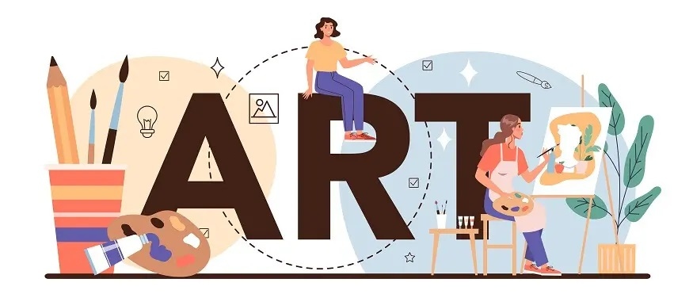
"Every child is an artist. The problem is how to remain an artist once we grow up."
– Pablo Picasso

