Slide 1

Classroom Management
Strategies and Best Practices
Prepared & Presented By:
Vijay Jangra

Slide 2
Introduction to Classroom Management
Classroom management is the process by which teachers create and maintain an optimal learning environment for their students.
Effective classroom management ensures that learning activities run smoothly, disruptions are minimized, and students remain engaged.
Well-managed classrooms foster a sense of safety, respect, and cooperation, enabling students to achieve academic and personal growth.
Today we explore key strategies, techniques, and the use of energizers to promote effective classroom management.

Slide 3

Key Components of Classroom Management

Slide 4
Establishing Clear Expectations and Rules
Define Rules Early: At the beginning of the school year, clearly outline rules and expectations.
Consistency: Enforce rules consistently to maintain fairness and order.
Positive Reinforcement: Recognize and reward good behavior to encourage adherence to rules.

Slide 5
Building Positive Relationships
Respect and Trust: Show students that you respect them, and they will likely reciprocate.
Communication: Listen actively to students and encourage them to express their concerns.
Personal Interest: Get to know students' interests, strengths, and weaknesses to create a supportive environment.

Slide 6
Organizing the Physical Environment
Seating Arrangement: Arrange desks to suit different teaching styles (e.g., rows for independent work, clusters for group activities).
Visibility and Accessibility: Ensure you can see all students and they can see learning materials.
Minimize Distractions: Keep the classroom organized to reduce clutter and distractions.

Slide 7
Engaging Lesson Plans
Variety of Activities: Use a mix of lectures, discussions, group work, and hands-on activities.
Clear Objectives: State learning goals at the start of each lesson.
Interactive Learning: Involve students actively in the learning process.

Slide 8
Time Management
Structured Routines: Establish predictable daily routines to provide stability.
Transitions: Plan smooth transitions between activities to minimize downtime and disruptions.
Prompt Start and End: Begin lessons on time and conclude with a summary or reflection activity.

Slide 9
Handling Disruptions Effectively
Non-Verbal Cues: Use gestures or eye contact to address minor disruptions.
Proximity Control: Move closer to students who are off-task to encourage focus.
Private Conversations: Address behavioral issues privately rather than publicly.

Slide 10

Strategies for Effective
Classroom Management

Slide 11
Positive Reinforcement
Rewarding positive behavior motivates students to follow rules and engage in learning. Examples include:
Verbal Praise: "Great job participating in the discussion!"
Classroom Rewards: Stickers, certificates, or points systems.
Privileges: Extra free time, choosing group partners, or leading an activity.

Slide 12
Restorative Practices
Restorative practices focus on resolving conflicts and repairing relationships. Strategies include:
Restorative Circles: Allow students to discuss issues and find solutions collaboratively.
Mediation: Facilitate conversations between students involved in conflicts.

Slide 13
Clear and Concise Instructions
Give step-by-step directions and check for understanding.
Use visual aids and demonstrations to support verbal instructions.
Engaging Classroom Discussions
Use open-ended questions to encourage critical thinking.
Allow students to lead discussions and express their ideas.

Slide 14
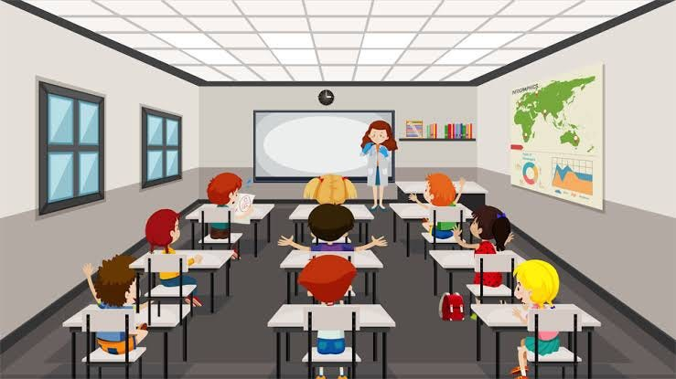
Energizers and Their Use in the Classroom

Slide 15
What Are Energizers?
Energizers are short, interactive activities designed to refresh and refocus students.
They are particularly useful when students seem tired, distracted, or disengaged.
Energizers promote physical movement, mental alertness, and social interaction.

Slide 16
Benefits of Using Energizers
Re-Engage Students: Boost energy and focus after long periods of study.
Improve Concentration: Short breaks improve cognitive performance.
Build Community: Foster a sense of teamwork and cooperation.
Reduce Stress: Fun activities help students relax and reduce anxiety.

Slide 17
When to Use Energizers
Transition Periods: Between lessons or activities.
Before Difficult Tasks: To prepare students for challenging content.
After Breaks: To refocus attention when returning to the classroom.
Mid-Lesson: To counteract fatigue during long lessons.

Slide 18

Examples of Energizers

Slide 19
"Simon Says"
Type: Physical and Listening Activity.
Use: Reinforces listening skills and quick thinking.
Instructions: Call out commands ("Simon says touch your nose") and students follow, but only if the instruction starts with "Simon says."

Slide 20
"Freeze Dance"
Type: Movement and Music Activity.
Use: Gets students moving and smiling.
Instructions: Play music while students dance. Pause the music, and everyone must freeze in place.

Slide 21
"Two Truths and a Lie"
Type: Social and Critical Thinking Activity.
Use: Helps students learn about each other.
Instructions: Each student shares two true statements and one false statement. The class guesses which one is the lie.

Slide 22
"Stretch and Breathe"
Type: Relaxation and Focus Activity.
Use: Calms and resets the mind.
Instructions: Lead students through a series of simple stretches and deep-breathing

Slide 23
"Silent Ball"
Type: Focus and Coordination Activity.
Use: Encourages quiet engagement.
Instructions: Students toss a ball silently to one another. If someone talks or drops the ball, they sit out until the next round.

Slide 24
Conclusion
Effective classroom management is essential for a productive learning environment.
By setting clear expectations, building positive relationships, and implementing engaging activities, teachers can create a classroom where students thrive.
Incorporating energizers helps maintain energy levels, focus, and a sense of fun, making the classroom a dynamic and enjoyable place to learn.

Slide 25


