Slide 1
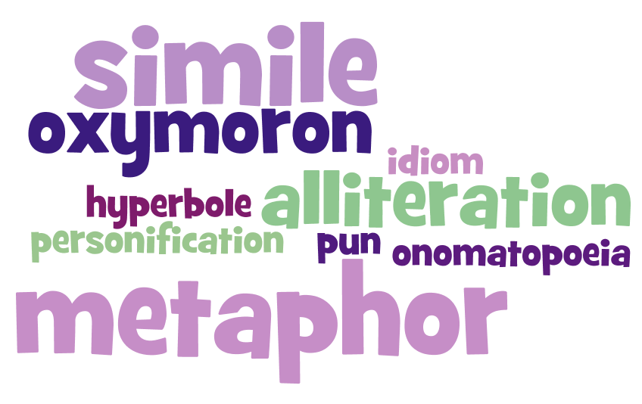


Poetry & Poetic Devices
Prepared By: Vijay Jangra
Presented By: Mahender Singh

Slide 2
Introduction to Poetry
Poetry is a form of literature that uses rhythm, sound, and vivid language to convey emotions, thoughts, and ideas.
Unlike prose, poetry often employs a structured format and relies on creative expressions to engage readers and listeners.
Poetry has been used across cultures for centuries to tell stories, celebrate events, and express personal feelings.
Today we will explore the fundamentals of poetry and various poetic devices that enhance the beauty and impact of poems.

Slide 3

Elements of Poetry

Slide 4
Form and Structure
Poems can take many forms, including:
Free Verse: No set rhyme scheme or meter.
Sonnet: A 14-line poem with a specific rhyme scheme.
Haiku: A 3-line poem with a 5-7-5 syllable structure.
Limerick: A humorous 5-line poem with an AABBA rhyme scheme.

Slide 5
Form and Structure
Rhyme and Rhythm
Rhyme: The repetition of similar sounds, especially at the end of lines (e.g., "moon" and "June").
Rhythm: The beat or cadence of a poem created by the arrangement of stressed and unstressed syllables.
Meter
Meter refers to the structured pattern of rhythm in a poem. Common types include:
Iambic Pentameter: Five pairs of alternating unstressed and stressed syllables.
Trochaic Tetrameter: Four pairs of alternating stressed and unstressed syllables.

Slide 6
Form and Structure
Stanza
A stanza is a group of lines forming a unit in a poem. Types of stanzas include:
  Couplet : 2 lines
  Quatrain : 4 lines
  Sestet : 6 lines
  Octave : 8 lines

Slide 7

POETIC DEVICES
Poetic devices are techniques used by poets to create more engaging and expressive poetry. These devices help enhance meaning, sound, and imagery.

Slide 8
Poetic Devices
1. Simile
  A simile compares two unlike things using the words "like" or "as."
  Example: "Her smile was as bright as the sun."
2. Metaphor
  A metaphor directly compares two unlike things by stating that one is the other.
  Example: "The classroom was a zoo."
3. Personification
  Personification gives human qualities to non-human objects or abstract ideas.
  Example: "The wind whispered through the trees."

Slide 9
Poetic Devices
4. Alliteration
  Alliteration is the repetition of the initial consonant sounds in a series of words.
  Example: "Peter Piper picked a peck of pickled peppers."
5. Assonance
  Assonance is the repetition of vowel sounds within nearby words.
  Example: "The early bird catches the worm."
6. Onomatopoeia
  Onomatopoeia refers to words that imitate natural sounds.
  Example: "Buzz," "Bang," "Splash."

Slide 10
Poetic Devices
7. Hyperbole
  Hyperbole is an intentional exaggeration for emphasis or humor.
  Example: "I have a million things to do today."
8. Imagery
  Imagery uses descriptive language to create vivid pictures in the reader's mind, appealing to the senses.
    Example: "The fragrance of freshly baked bread filled the air."
9. Symbolism
  Symbolism uses symbols to represent ideas or concepts.
  Example: "A dove symbolizes peace."

Slide 11
Poetic Devices
10. Repetition
  Repetition is the intentional reuse of words or phrases to emphasize a point.
  Example: "Never, never, never give up."
11. Irony
  Irony is the use of words to convey a meaning opposite to their literal meaning.
  Example: "It’s a beautiful day," said during a storm.
12. Enjambment
  Enjambment occurs when a line of poetry continues without a pause onto the next line.
  Example: "The sun sets slowly, draping the world in crimson."
13. Pun
  A pun is a play on words that exploits multiple meanings or similar-sounding words for a humorous effect.
  Example: "Time flies like an arrow; fruit flies like a banana."

Slide 12
Poetic Devices
14. Oxymoron
  An oxymoron pairs contradictory words for dramatic effect.
  Example: "Bittersweet memories."
15. Rhyme Scheme
  The rhyme scheme is the pattern of end rhymes in a poem, typically noted with letters (e.g., ABAB).
  Example: "The sun is high (A)
  In the clear blue sky (A)
  Birds start to sing (B)
  And spread their wing (B)"

Slide 13

Examples of Poems and Their Devices

Slide 14
Examples of Poems and Their Devices
1. "The Road Not Taken" by Robert Frost
  Devices: Metaphor, Imagery, Symbolism
  Sample Lines: "Two roads diverged in a yellow wood,
  And sorry I could not travel both."
2. "Daffodils" by William Wordsworth
  Devices: Simile, Personification, Alliteration
  Sample Lines: "I wandered lonely as a cloud
  That floats on high o'er vales and hills."

Slide 15
Activities for Students
Poetry Writing Exercise: Ask students to write a short poem using at least three poetic devices, such as simile, alliteration, and imagery.
Poetry Analysis: Provide a poem and ask students to identify and explain the poetic devices used.
Create a Visual Poem: Encourage students to create a poster or a piece of art that illustrates the theme and imagery of their favorite poem.
Poetry Recitation Competition: Organize a recitation event where students memorize and perform poems, focusing on expression and understanding of poetic devices.

Slide 16

Conclusion
Poetry is a powerful medium for self-expression and creativity.
By understanding and using poetic devices, students can appreciate the richness of language and enhance their reading and writing skills.
Incorporating poetry in the classroom encourages students to think imaginatively, develop empathy, and enjoy the beauty of words.

Slide 17


