Slide 1
Teaching of Grammar
Methods, Approaches, and Strategies
Prepared By: Vijay Jangra
Presented By: Mahender Singh

Slide 2
Introduction
Grammar, often referred to as the backbone of any language, encompasses the set of rules governing the structure and use of words, phrases, clauses, and sentences.
Teaching grammar effectively is a cornerstone of language education, whether it’s a first language (L1) or a second language (L2).
It equips learners with the necessary tools to communicate clearly and correctly.
However, the methodology of teaching grammar has evolved significantly, with various approaches and techniques being employed to suit different learning contexts.

Slide 3
Importance of Teaching Grammar
Foundation for Language Proficiency:
Grammar provides a structural framework for communication.
Accuracy and Clarity:
Helps avoid misunderstandings and errors.
Writing and Reading Skills:
Enhances reading comprehension and writing competence.
Critical Thinking:
Encourages analytical thinking about language structures.
Cultural Understanding:
Understanding grammar aids in interpreting cultural nuances embedded in language.

Slide 4

Approaches to Teaching

Slide 5
Deductive Approach
Definition: Rules are explained first, followed by examples and practice exercises.
Advantages:
Quick and straightforward.
Effective for learners who prefer structured learning.
Disadvantages:
Can be boring or demotivating.
May not promote deep understanding.
Example: Teaching the rule of subject-verb agreement before giving practice sentences.

Slide 6
Inductive Approach
Definition: Learners discover grammatical rules through exposure to examples and pattern recognition.
Advantages:
Encourages active learning and critical thinking.
Promotes retention and deeper understanding.
Disadvantages:
Time-consuming.
Can be confusing for some learners.
Example: Providing sentences like "She runs fast" and "They run fast" and guiding students to infer the rule of subject-verb agreement.

Slide 7
Implicit vs. Explicit Grammar Teaching
Implicit: Focuses on acquiring grammar naturally through meaningful interaction and exposure.
Example: Learning tenses through reading stories or dialogues.
Explicit: Direct instruction of rules and concepts.
Example: Teaching the structure of passive voice explicitly.

Slide 8
Descriptive vs. Prescriptive Grammar Teaching
Descriptive: Focuses on how language is actually used.
Prescriptive: Focuses on adhering to formal rules of language.
Classroom Strategy: Balancing both for contextual relevance.

Slide 9

Methods of Teaching

Slide 10
Grammar-Translation Method (GTM)
Description: Focuses on translating sentences between the target language and the native language.
Pros:
Builds vocabulary and grammatical knowledge.
Useful for understanding literary texts.
Cons:
Lacks focus on speaking and listening skills.
Can be monotonous.

Slide 11
Direct Method
Description: Emphasizes speaking and listening without translation; grammar is taught inductively.
Pros:
  Promotes natural language use.
  Enhances fluency.
Cons:
  Requires skilled teachers.
  Limited focus on explicit grammar rules.

Slide 12
Audio-Lingual Method
Description: Based on habit formation through repetition and drills.
Pros:
Good for pronunciation and memorization.
Cons:
Does not encourage creativity.
Overemphasis on rote learning.

Slide 13
Communicative Language Teaching (CLT)
Description: Focuses on communication and real-life language use; grammar is taught in context.
Pros:
Practical and engaging.
Encourages fluency and comprehension.
Cons:
May neglect accuracy.
Activities: Role-plays, group discussions, interviews.

Slide 14
Task-Based Language Teaching (TBLT)
Description: Learners complete meaningful tasks where grammar is used naturally.
Pros:
Contextual and engaging.
Cons:
Requires careful planning.
Example Tasks: Planning a trip, writing a letter, conducting a survey.

Slide 15
Effective Strategies for Teaching Grammar
Use Contextual Examples: Embed grammar lessons within stories, articles, or real-world situations.
Incorporate Visual Aids: Diagrams, charts, and infographics to illustrate grammar rules.
Games and Activities: Grammar games like “Find the Error”, crossword puzzles, and bingo.
Scaffolding: Gradually increase the complexity of grammar tasks.
Peer Learning and Collaboration: Group work and peer feedback to reinforce learning.
Technology Integration: Use of grammar apps, online quizzes, and interactive platforms like Kahoot! and Quizizz.
Error Correction and Feedback: Balancing immediate correction with encouraging self-correction.

Slide 16
Teaching Grammar to Different Age Groups
Young Learners (Primary Classes):
Use songs, rhymes, and stories.
Focus on basic structures like nouns, verbs, and simple tenses.
Adolescents (Secondary Classes):
Mix direct instruction with communicative activities.
Address more complex structures (e.g., conditionals, passive voice).
Adults:
Connect grammar to professional and everyday needs.
Encourage self-analysis and contextual practice.

Slide 17
Challenges in Teaching Grammar
Lack of Motivation: Solution: Use engaging activities and real-life examples.
Overemphasis on Accuracy: Solution: Balance accuracy with fluency.
Complex Rules: Solution: Break down rules into simpler components and use analogies.
Language Interference: Solution: Address common errors caused by L1 interference.

Slide 18
Conclusion
Effective grammar teaching blends a variety of methods and approaches to suit learners’ needs and contexts.
Whether through direct instruction, communicative practice, or task-based activities, the goal remains the same: to enable learners to use language accurately, fluently, and confidently.
By adopting innovative techniques and addressing common challenges, teachers can make grammar lessons both informative and engaging, ultimately enhancing overall language proficiency.

Slide 19
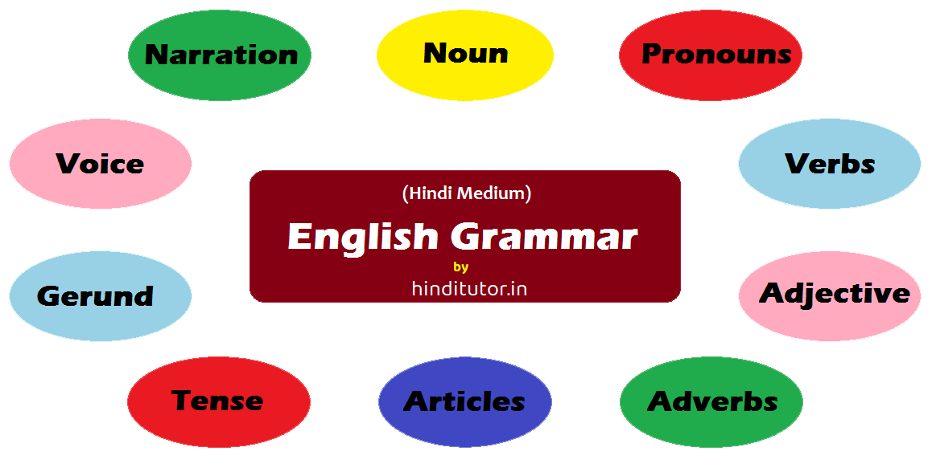
THANK
YOU

